Slide 1
S5/S6 Curricular Pathways 2018/19
Mrs P Davie, DHT S5/6

Slide 2
What pathways are available?
Stay on for S5 and S6
Flexible and bespoke learner journeys
Leave school – if 16 years before 30th September, 2018
Stay at school until Christmas – if 16 years between 1st October and 28th Feb 2019
Attend college, training, work experience etc. until Statutory leaving age – by agreement with Chief Education Officer

Slide 3
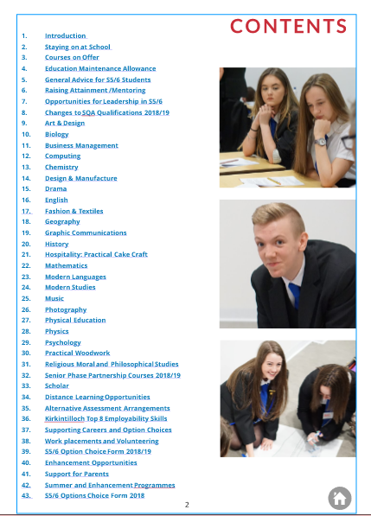
what options available?
National 5, Higher and Advanced Higher
Senior Phase Partnership Programme (College)
Foundation Apprenticeships (College and Work Placement)
Opportunities for Volunteering
Leadership opportunities

Slide 4
S5/6 School preparation
1st Block of Supported Study (October – December 2017)
Early warning interim report October 2017
S5/6 Full Reports November 2017
S5/6 Mentors appointed
Prelim Analysis & further Interim Report Feb 2018
Parent Information Evening Tuesday 27th Feb
2nd Block of Raising Attainment Sessions (Feb - March)
Easter Revision (April)
Reach / Access Programme UoG
Top Up Programme – UoG
Summer Schools and Enhancement Opportunities

Slide 5
Preparation for Choice
Information evening Guidance interviews begin 21st February for S4 & S5
Departmental advice is ongoing. PSE sessions focusing on options
Online options brochure
Guidance interviews
Return of Senior Phase S4/5/6 Option Form by 7th March
Review of option choices after SQA results August 2018
Opportunities throughout the year to meet different industries and attend career events
#Kirkintillochhs
Glow

Slide 6
Guidance Team Who can help?
Who can help?
S5/6 year head
Mr George Stevenson
Mrs Barbara Dunlop/Mr Trevor Joice
Mrs Maureen Hayworth
Mrs Ros Hay
Mrs Pam Davie
PT developing the young workforce
Raising attainment team
Mr Andrew Kennedy
Mr Robert Leadbeater
Mr Mark Kay
Careers advisor
PT Support for Learning
Mrs Shona Deans
Mrs Lorraine Early

Slide 7
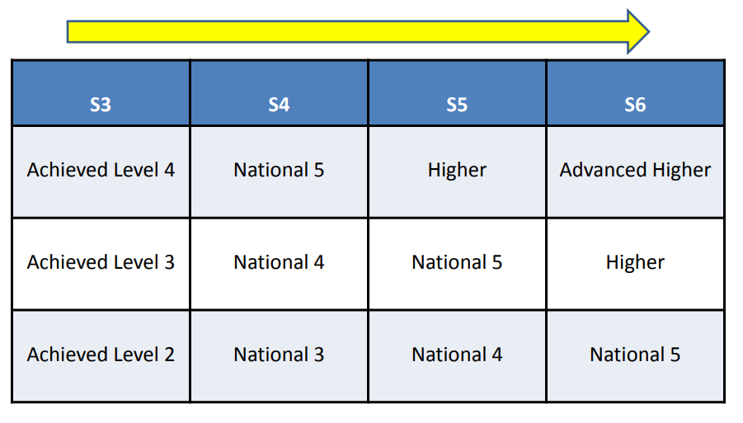
Curriculum For Excellence – A Two Phase Model
S1 – S3 : Broad General Education
S4 – S6 : Senior Phase (SQA Certification)

Slide 8
The journey so far (subjects studied)
Year | Number of subjects
S1 | 17
S2 | 17
S3 | 13
S4 | 7
S5 | 5
S6 | 5

Slide 9
The Number of options in Senior phase
7 subjects in S4 reduce to 5 subjects in S5
A minimum of 4 in S6 with SQA Leadership Award in additional column
CHOOSE BEST SUBJECTS CREATING COHERENCE WHERE POSSIBLE !
Column A 6 periods
Column B 6 periods
Column C 6 periods
Column D 6 periods
Column E 6 periods
+ 2 periods – PSE/PE/RE/Wider Achievement/Leadership

Slide 10
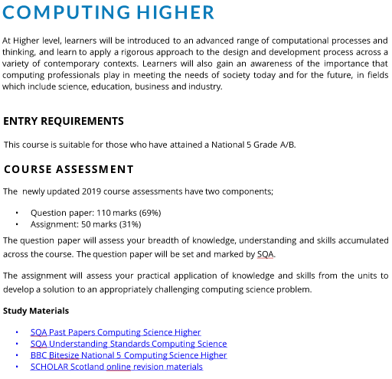
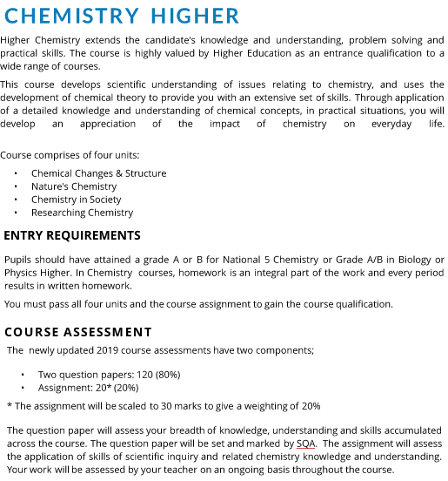
Changes to higher qualifications in 2019

Slide 11
Methods of assessment
Assignment
Case Study
Practical Activity
Performance
Portfolio
Project
Question paper/test

Slide 12
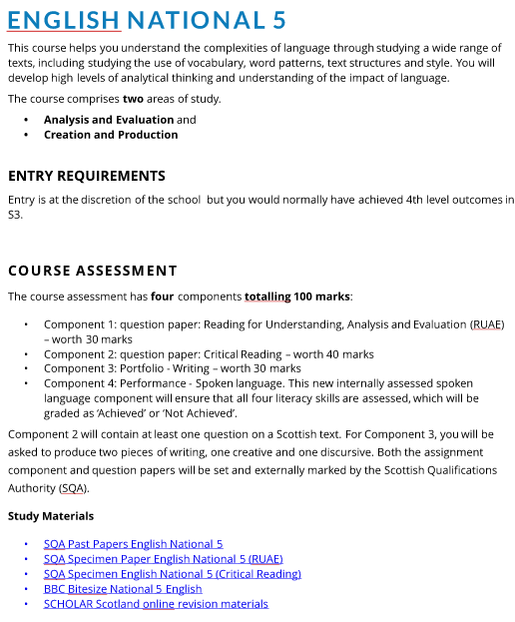

Slide 13
S5/6 Options brochure

Slide 14
Positive reasons for choice
Ability & aptitude
Related to possible career or Further/Higher Education
Enjoyment
A balanced set of subjects
Ask for help or information from subject teachers
Ask your school’s career adviser or Mr Kennedy if you need help
talk to your parents/carers about your ideas and options

Slide 15
negative reasons for choice
It’s what your friends are doing
You like the teachers in that department
You like a certain teacher
Choose a subject without finding out as much as you can about it – including how it will be taught
Limit your future career options by thinking that some subjects and careers are only for girls or boys.

Slide 16
“Good things come to those who wait… But better things come to those who work for it.”

Slide 17
Keys to Success in the Senior Phase
Getting the options right - It is a lengthy process but reviewed in August 2018
Choose your 5 best subjects in S5 (minimum of 4 plus Leadership in S6)
Avoid ‘crashing’ subjects in S5
Dropping subjects not possible
2 year plan to meet requirements
Pupils should devote at least four hours per subject per week to home study.

Slide 18
Subject choice in S6 (UCAS)
In both cases, it is important to check the entry requirements, to find out what credit is given to Advanced Highers for the courses which interest you or what Highers are required for entry.

Slide 19
Keys to Success in the Senior Phase
In S5 choose your 5 best subjects from S4
In S6 choose to specialise through AH or gain breadth through additional N5/Higher subjects
Avoid ‘crashing’ in S5
Look at a 1/2 year plan to meet requirements
Take subjects which will develop and demonstrate relevant skills, e.g. essay based subjects for Social Sciences or Business; Art/Graphic Communication for Architecture

Slide 20
How to stand out from the crowd
Commitment to Scouts/Football/Cadets/St Andrews Ambulance
Volunteering
Finding work experience
Resilience – attending ALL Raising Attainment sessions
Strathclyde University Summer School (S@S Accelerate) S4 & 5

Slide 21
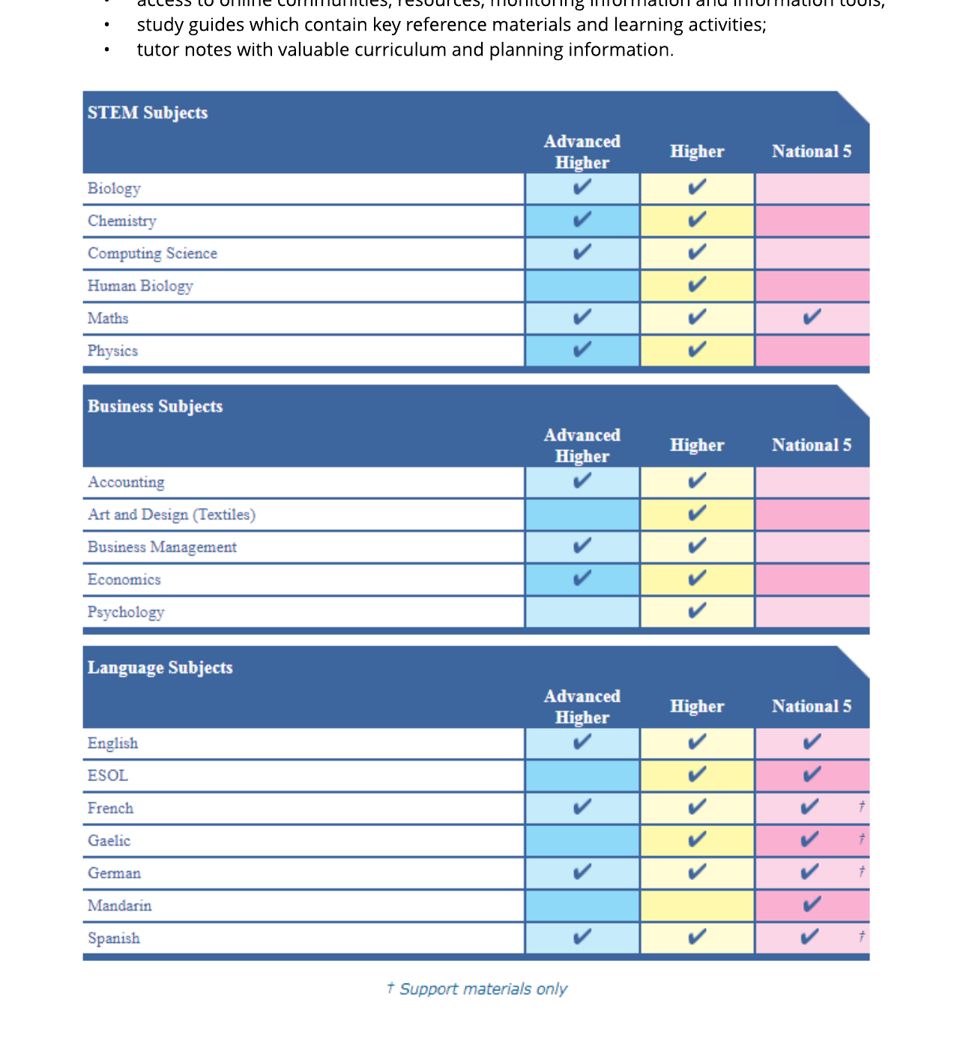
Scholar resourcesonline

Slide 22
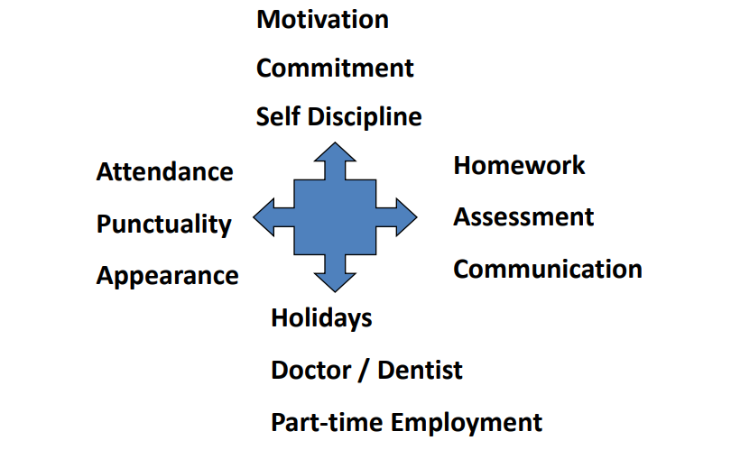
Expectations from senior pupils
Motivation
Commitment
Self discipline
Homework
Assessment
Communicationr
Attendance
Punctuality
Appearance
Holidays
Part-time jobs
Self found volunteering and work experience

Slide 23
Kirkintilloch High School S5/6 Options Choice Form 2018/19
Name _____________________________________ Class _____________
Career Aspiration _________________________________________________________ (Please indicate your choice of subjects below even if you are considering leaving school)
Level | Column A | Column B |  | Column C | Column D | Column E
AH (S6 Only) | Biology Chemistry Physics |  | English Maths French History |  | Drama Geography Art & Design Modern Studies
Higher | Maths Intensive Maths* (S6 only) Chemistry PE Design & Manufacture Psychology | English Physics Geography Drama Fashion & Textiles |  | Maths Intensive Maths* (S6 only) Art & Design History RMPS Computing Psychology | English Music Modern Studies Art & Design Spanish Business Management | English Graphic Communication Human Biology French Photography RMPS
N5 | Maths PE Chemistry Travel & Tourism | English NPA Acting & Performance Fashion & Textiles Geography Physics |  | Maths History Computing Practical Cake Craft | English Practical Woodwork Music Spanish Modern Studies | French Graphic Communication Biology RMPS
College/ University Partnership |  |  |  | Tues/Thurs Afternoon Options Foundation Apprenticeships GCU Fashion Brand Retailing
If your choice is not available, please note it on the back of this form.
S5 must choose 5 subjects and S6 choose at least 4 plus Leadership (SCQF Level 6)
Pupils going into S5 MUST not “Crash” a subject. You should pick your 5 strongest subjects from S4.
Some courses are S6 only due to the nature of the course content and limited resources to deliver these courses.
All courses are subject to minimum numbers.
* S6 Intensive Maths runs across two columns and must be elected in both columns.
AH’s are not yet designated columns and will be determined by numbers. Consortium arrangements in partnership with neighbouring EDC schools may be used should numbers not be viable.
Please return to your Guidance Teacher by 7th March 2018
Guidance Signature
_____________________________________
Pupil Signature ______________________________________
Parent/Carer Signature ______________________________________

Slide 24
The senior phase partnership programme 2018
Wide range of courses which offers young people a variety of options with most accredited by the SQA
Purpose is to help young people develop skills for learning, life and work and support the transition from school
Open to pupils in S4-6 from August 2018
Delivery is over 2 afternoons for 1 academic year or 2 academic years for Foundation Apprenticeships
Courses are delivered at partner colleges
Courses range from SCQF Level 3 – 7
Information and application forms can be found in Options booklet (paper brochures available). College application deadline 20th March 2018
Foundation Apprenticeship application deadline 22nd March 2018.

Slide 25
58 courses offered over 4 sectors:
Care, Health & Sports Industries
Creative & Digital Industries
Business & Service Industries
Science, Engineering, Design & Manufacture Industries

Slide 26
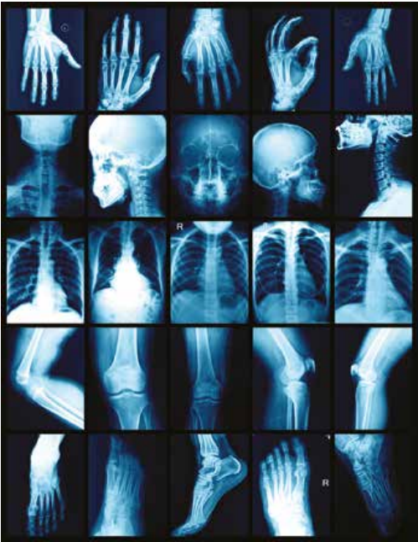
Care, Health & Sports Industries
Applied Anatomy
Care
Early Education & Childcare
Health, Child & Social Care
Introduction to Nursing
Practice & Social Care Skills
Coach4Success
Dance
Sport Fitness & Outdoor Education
Transitions

Slide 27
BUSINESS & SERVICE INDUSTRIES
Fashion Brand Retailing
Hospitality, Events & Tourism
Intro to Food Services
Journalism
Professional Cookery
Bakery
Scots & Criminal Law
Supply Chain Operations
Financial Services
Intro into Teacher Education (Aug –Dec)

Slide 28
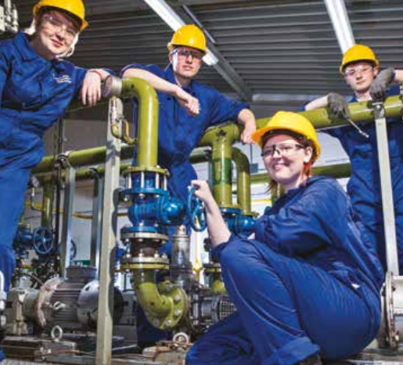
SCIENCE, ENGINEERING, DESIGN & MANUFACTURE
Automotive Engineering
Building Services Engineering
Mechanical Engineering
Computer Aided Design
Construction
Construction Crafts
Construction Skills for Young Women
Construction Management
Exploring Science
Maritime Skills

Slide 29
CREATIVE & DIGITAL INDUSTRIES
Cyber Security
Computer Games Development
Creative Digital Media
Hair & Make-Up Artistry
Hairdressing
Beauty Skills
Personal Presentation
Professional Theatre
Television Production
Sound Production: Recording

Slide 30
Foundation apprenticeships
Gain a qualification recognised by employers
Gain experience in your chosen career while still at school
Develop self-confidence, problem solving and leadership skills
Enhance your job prospects or college/university application
S5/6 pupils with a strong desire to work in industry
Ability to achieve at least one Higher grade by S6
Subject specific entry requirements
Accredited entry to a Modern Apprenticeship
College/University/Employment
2 Year - Tuesday and Thursday 1.30 pm – 4.30 pm
1 Year - Tuesday and Thursday 9.00 am – 4.30 pm
Delivered in City of Glasgow, Glasgow Clyde or Glasgow Kelvin College – FA Application Form

Slide 31
College and foundation apprenticeship timeline 2018
Prospectus available in schools and online via school website
Pupils discuss senior phase courses with their Guidance Teacher during the option choice process
Online Application Forms completed - 20 March 2018
Additional FA Application Form – 22 March 2018
Applicants and parents invited to Partnership Information Evening - April 2018
College induction/interview process - June 2018
Courses start for successful pupils – August 2018

Slide 32
Making the Most of the Curriculum
Competition for positive destinations is greater than ever
Currency in the form of exam results and experiences makes the difference
‘Banking’ highest qualifications possible in S5 allows pupils to utilise the flexibility of the S6 timetable
One way to differentiate between two students applying for the same course is by giving greater weight to academic achievements on ‘first sitting’

